Slide 1
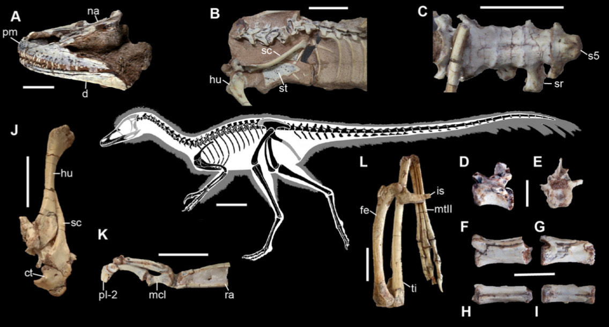
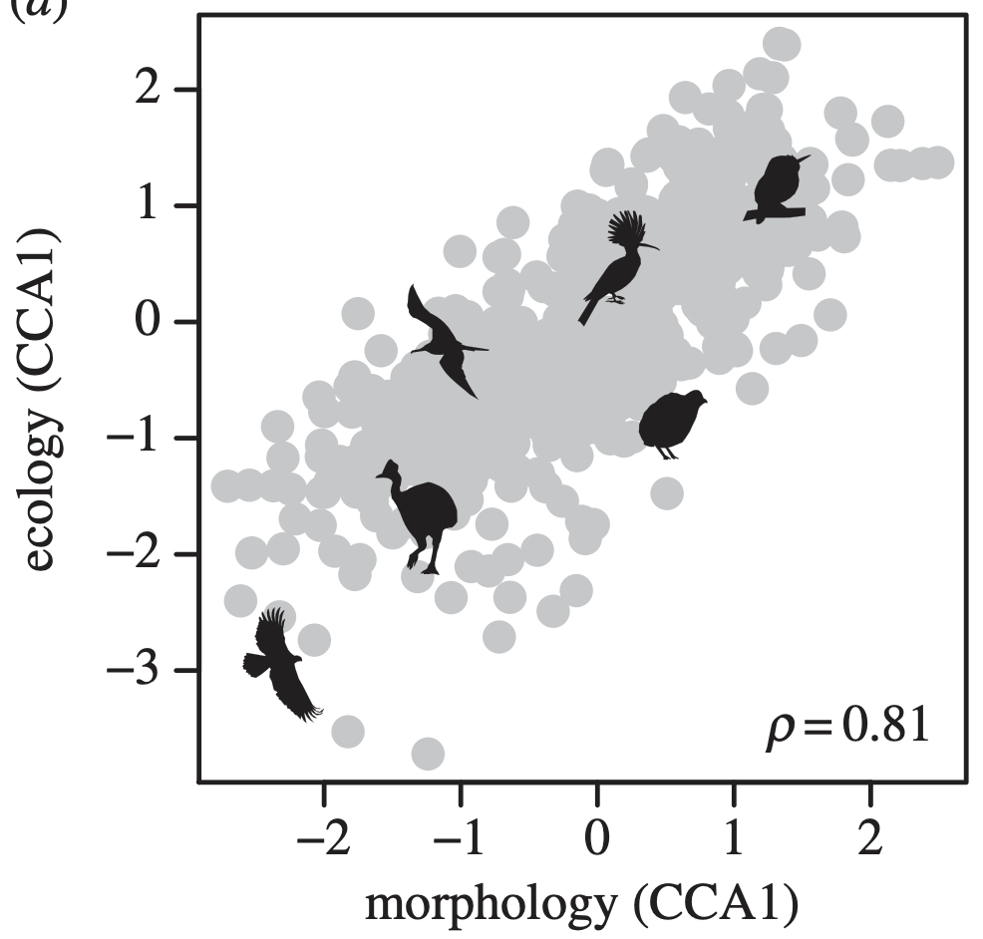
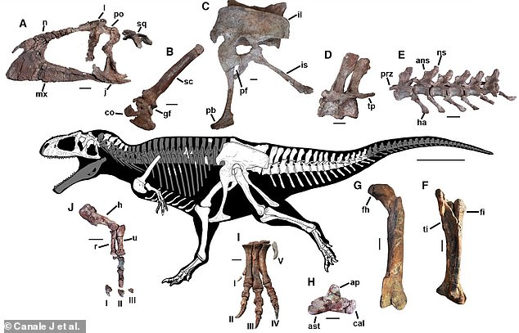
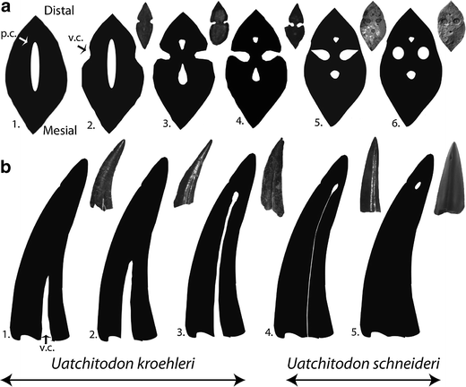
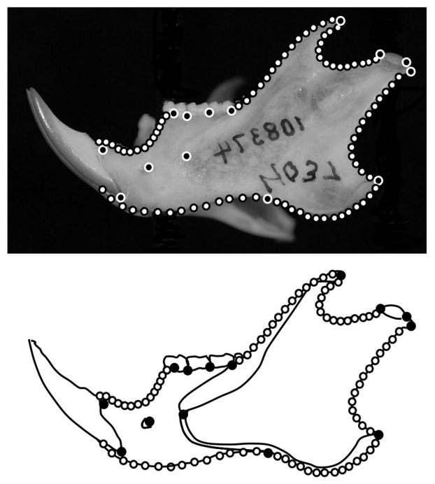
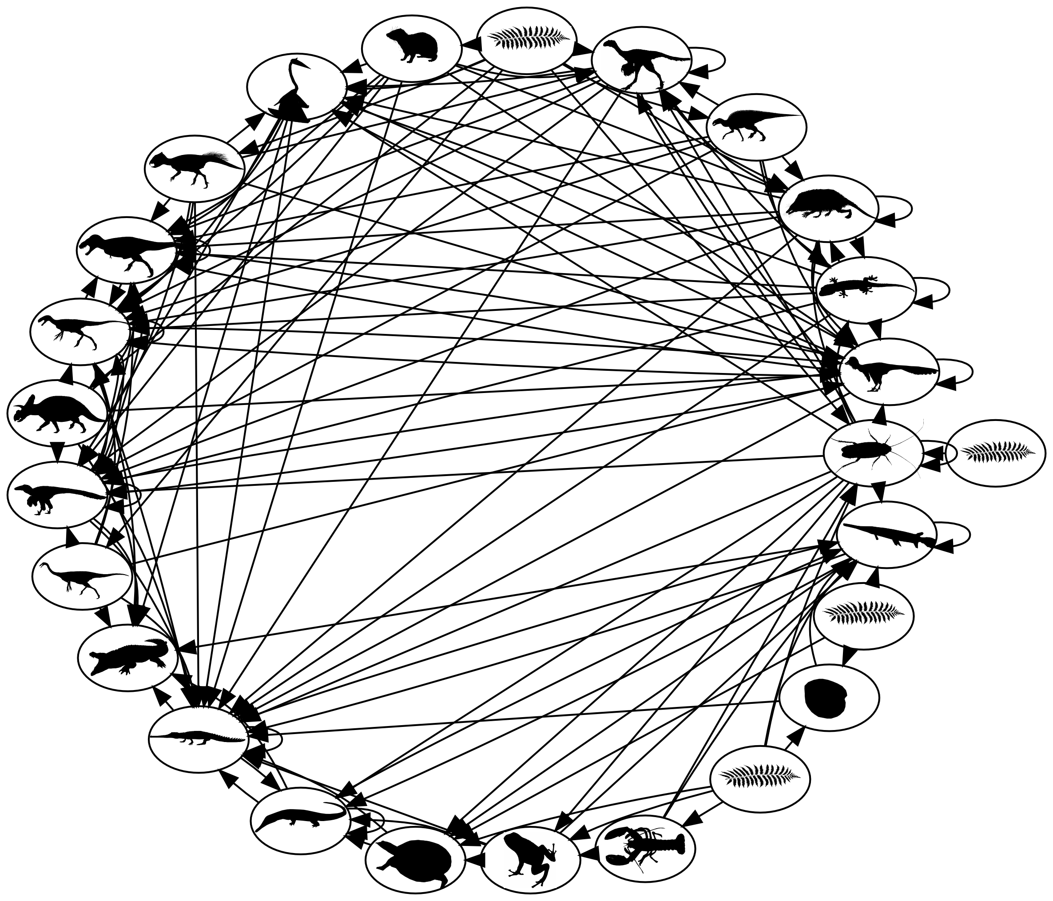
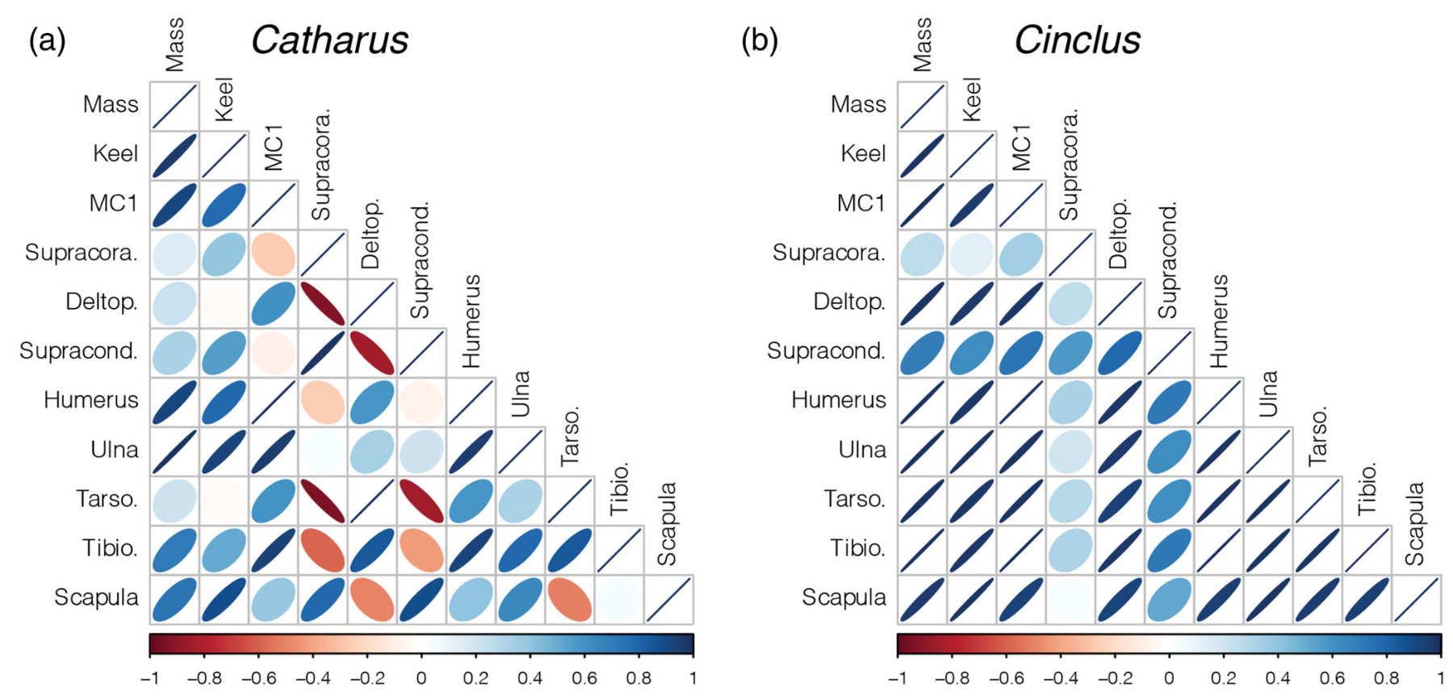
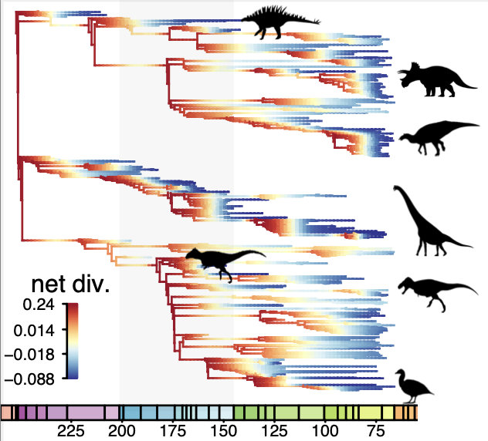
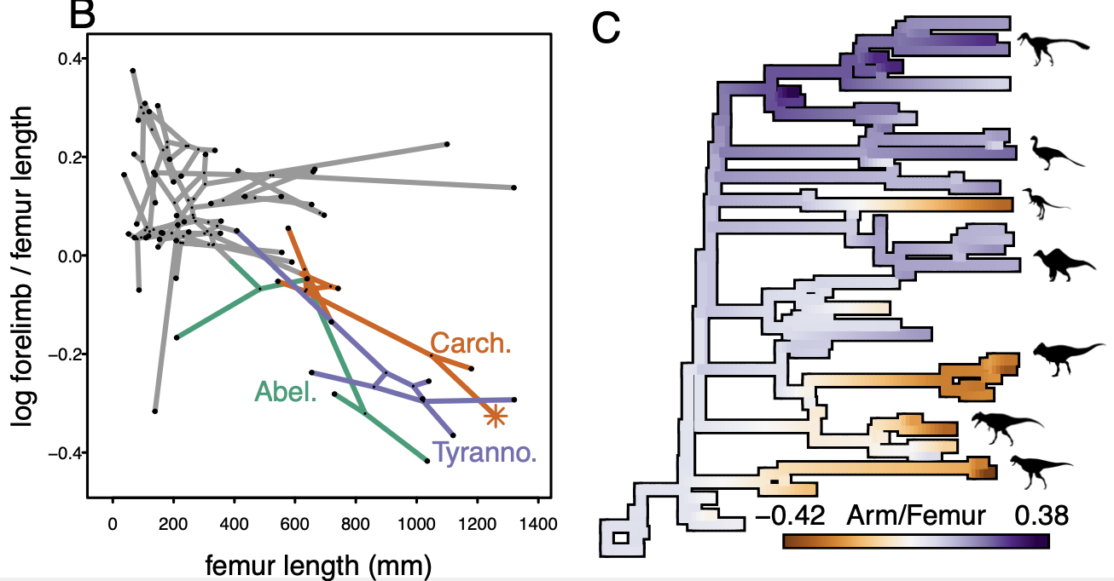
Research Interests: Jon Mitchell

Slide 2
Background
Started research as undergrad at App State

Slide 3
Background
Started research as undergrad at App State
Ph.D. on bird fossil ecomorphology

Slide 4
Background
Started research as undergrad at App State
Ph.D. on bird fossil ecomorphology
Postdoc on macroevolutionary rates

Slide 5
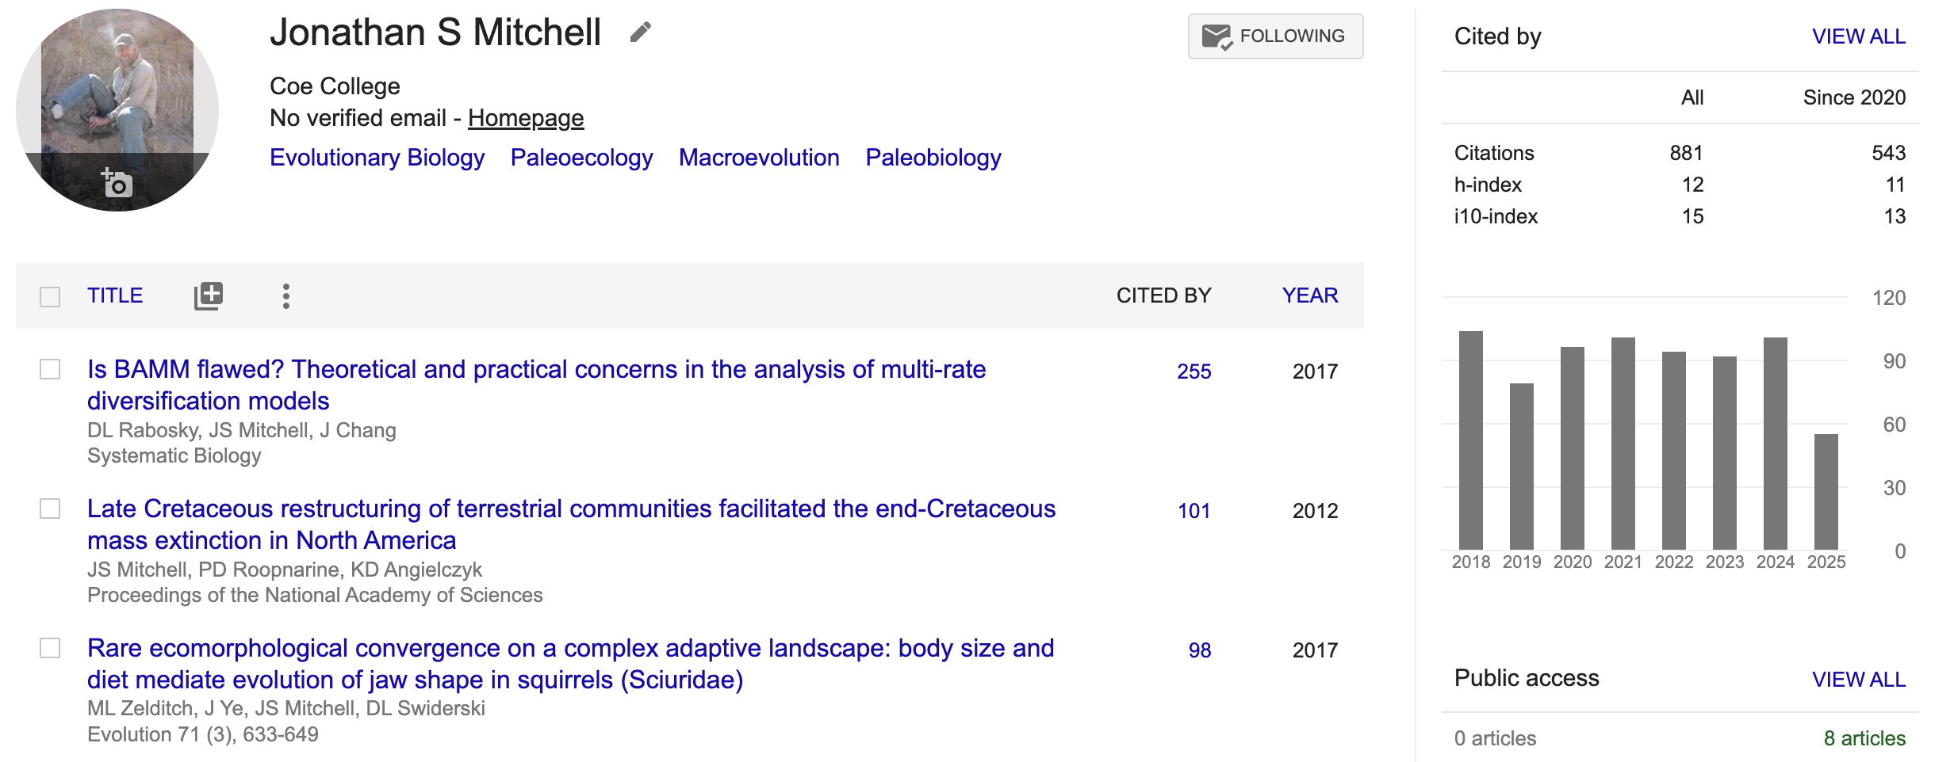
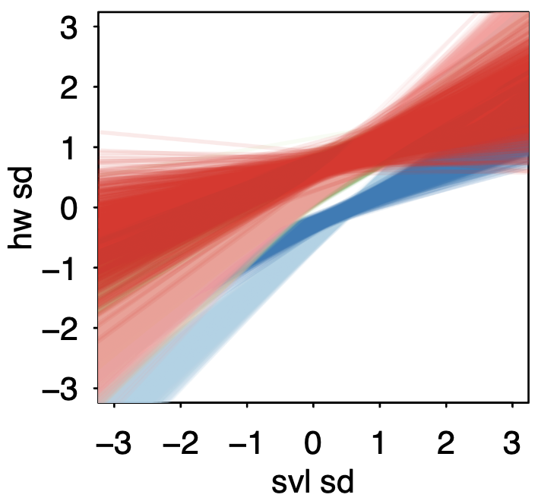
Background – Current Interests
Started research as undergrad at App State
Ph.D. on bird fossil ecomorphology
Postdoc on macroevolutionary rates
Major research interests
How ecology drives evolution in vertebrates
Living species – dipper bird limbs, swallow feather colors, squirrel jaw shape, frog size

Slide 6
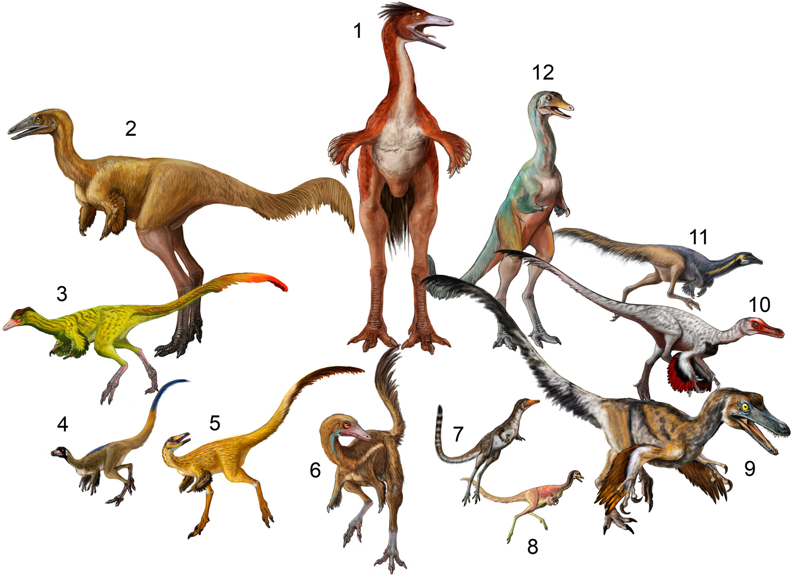
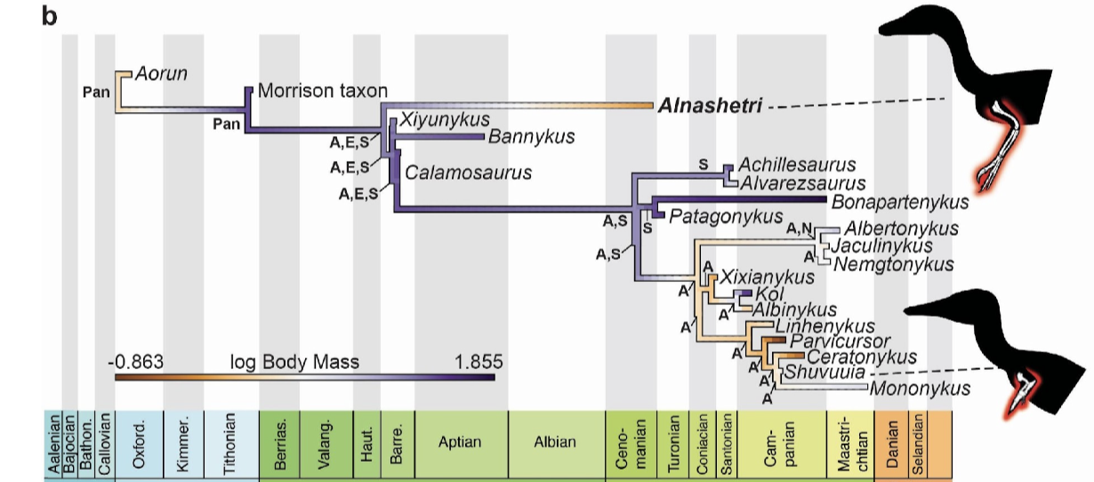
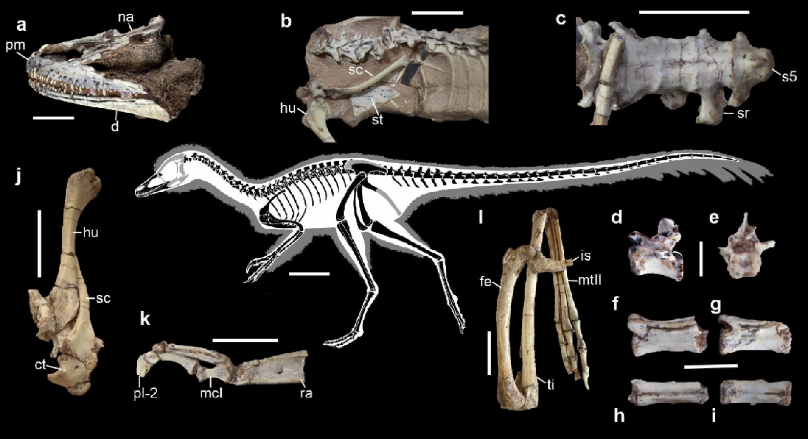
Current Interests
Started research as undergrad at App State
Ph.D. on bird fossil ecomorphology
Postdoc on macroevolutionary rates
Major research interests
How ecology drives evolution in vertebrates
Living species – dipper bird limbs, swallow feather colors, squirrel jaw shape, frog size
Extinct species – all sorts of weird stuff, from Egyptian owls to giant dinosaurs

Slide 7
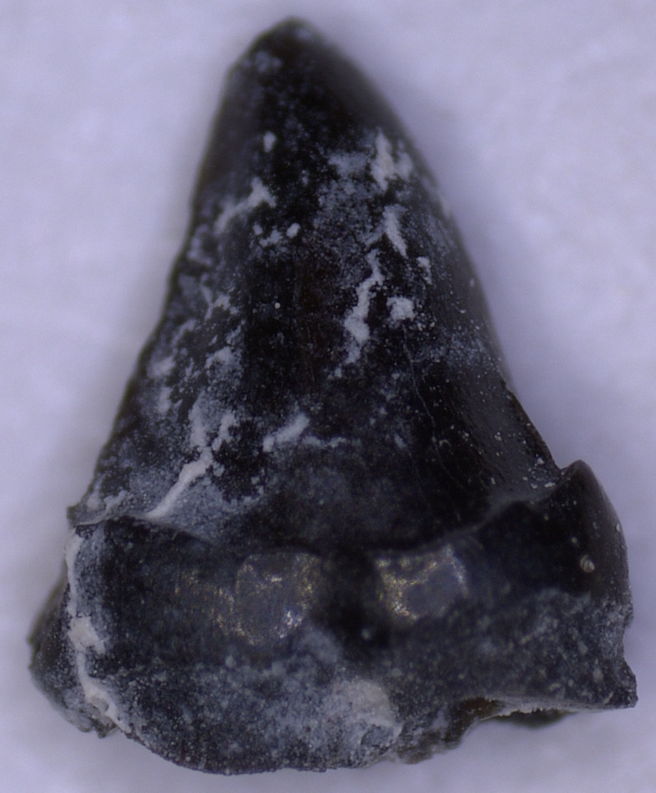
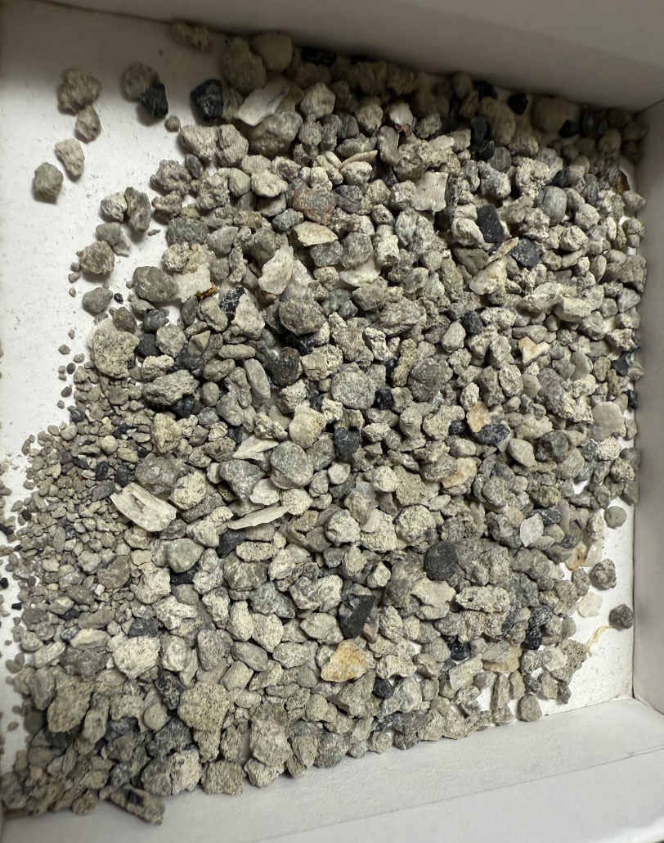
Current Interests
Started research as undergrad at App State
Ph.D. on bird fossil ecomorphology
Postdoc on macroevolutionary rates
Major research interests
How ecology drives evolution in vertebrates
Living species – dipper bird limbs, swallow feather colors, squirrel jaw shape, frog size
Extinct species – all sorts of weird stuff, from Egyptian owls to giant dinosaurs
How vertebrate evolution changes ecosystems

Slide 8
Current Projects
100 million year old sand from Utah (need many students!)
Dinosaur diets (need a student!)
Dinosaur growth rates (need a student!)
Intraspecific variation & macroevolutionary rates**
Random old projects (Washakie bird)
Whatever projects pop up (Megan’s frogs, Mozes’ biomechanics)

Slide 10
Evolution
Microevolution: how do births & deaths change the frequency of heritable traits in a population
Macroevolution: how do speciations & extinctions change the frequency of heritable traits in a lineage
Example: colonial corals live longer, solitary corals speciate more often
(Mesoevolution: how do developmental biases change the frequency of heritable traits in a group)

Slide 11
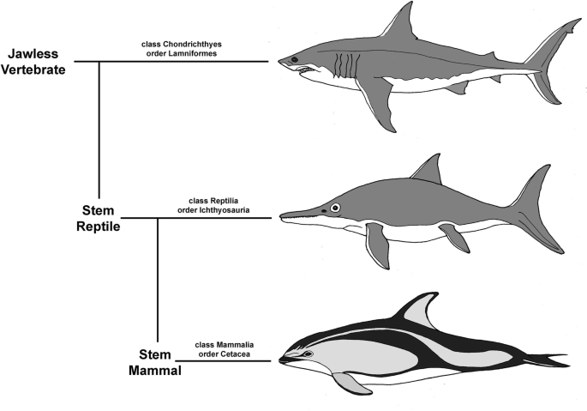
Convergent Evolution
Different organisms repeatedly evolving the same form in response to the same ecology

Slide 12
Research interests generally
Changes in a species’ evolution due to changes in ecology
jaw shape in squirrels, feather changes in flightless birds, wing shape in swallows
Changes in how an ecosystem is structured due to species evolving
changes in composition of sites (Cedar Mtn Fm)
How do changes in ecosystem structure impact broad evolutionary change
Food webs & Ki/Kj

Slide 13
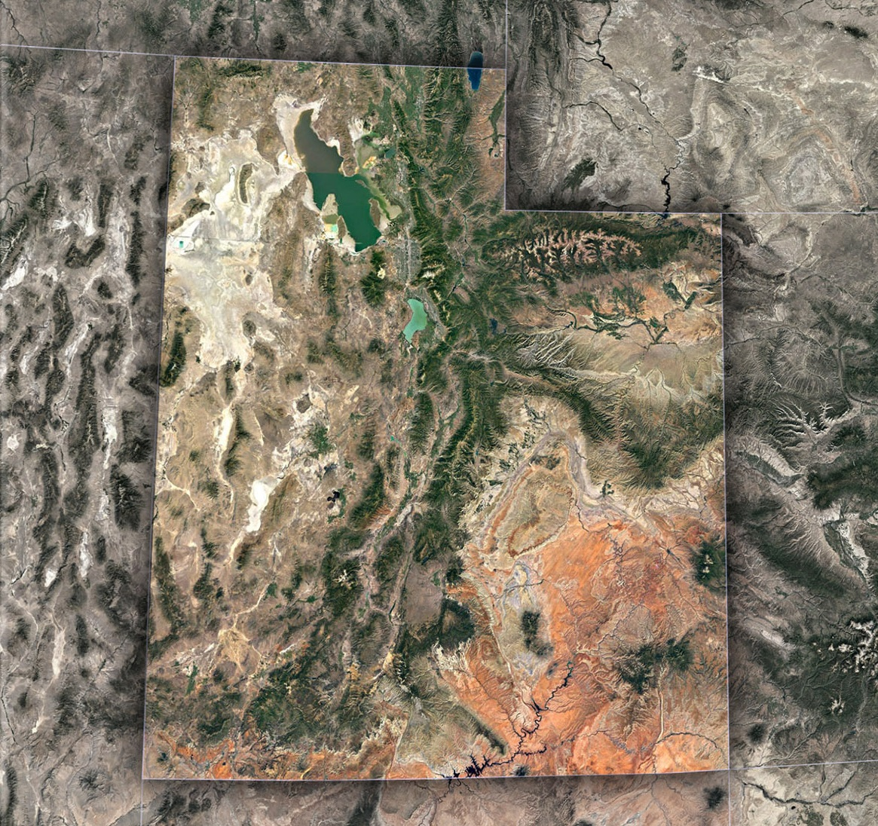

Slide 15
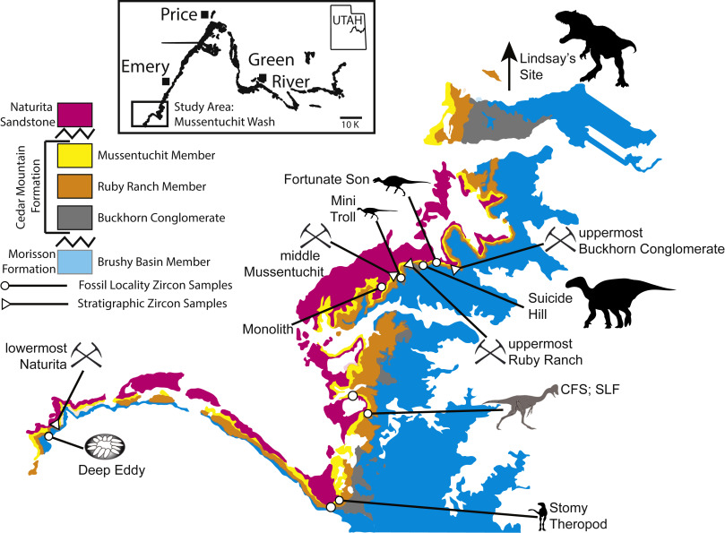
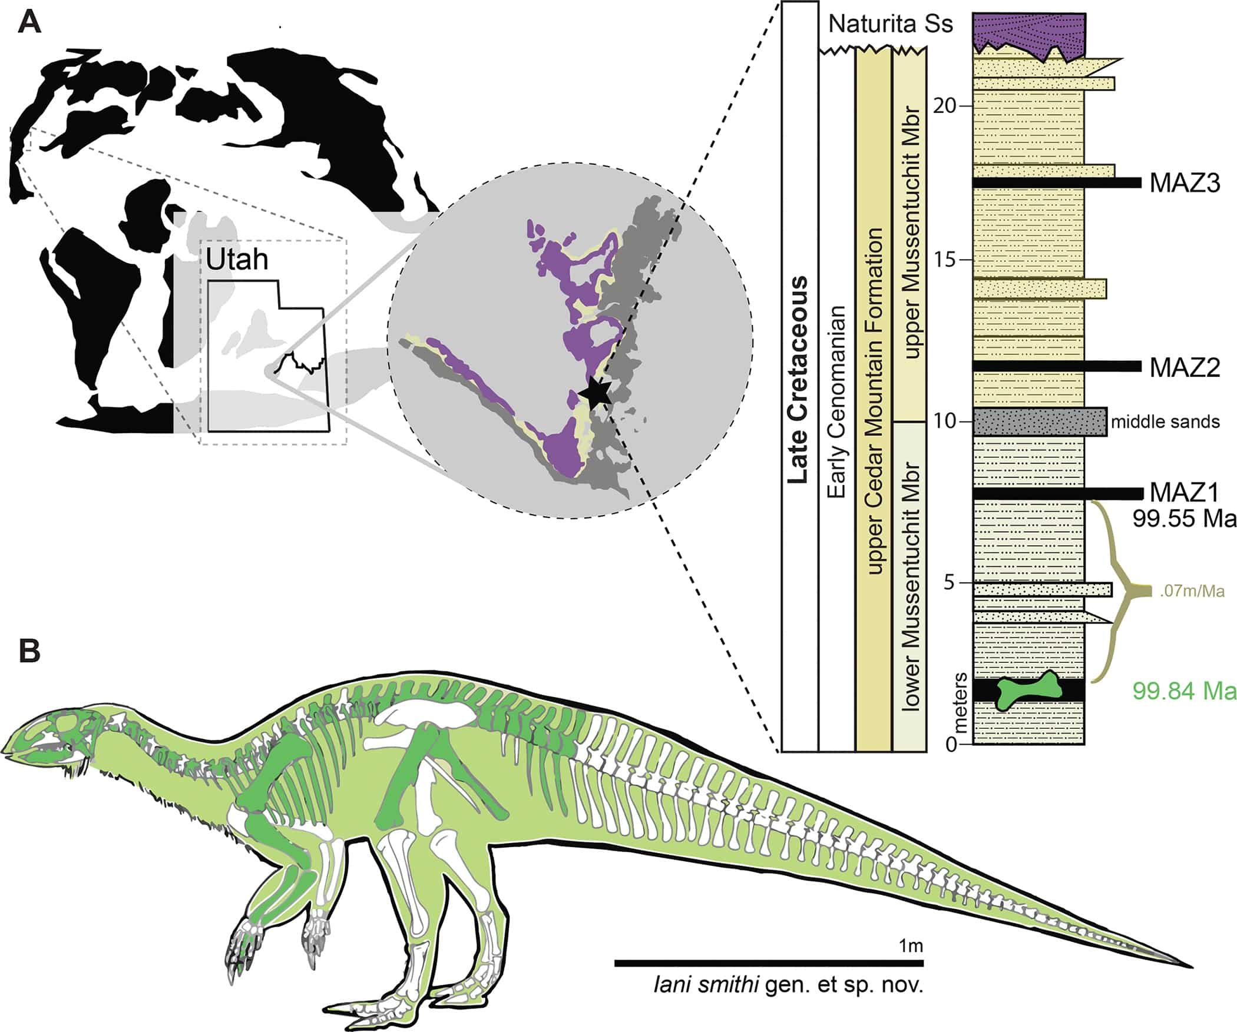
Notes:
Iani smithi (monolosaurus)
https://www.sciencedirect.com/science/article/abs/pii/S0195667119304069
https://journals.plos.org/plosone/article?id=10.1371/journal.pone.0286042

Slide 16
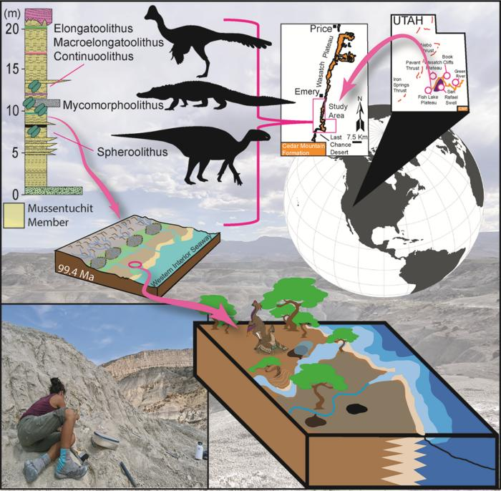
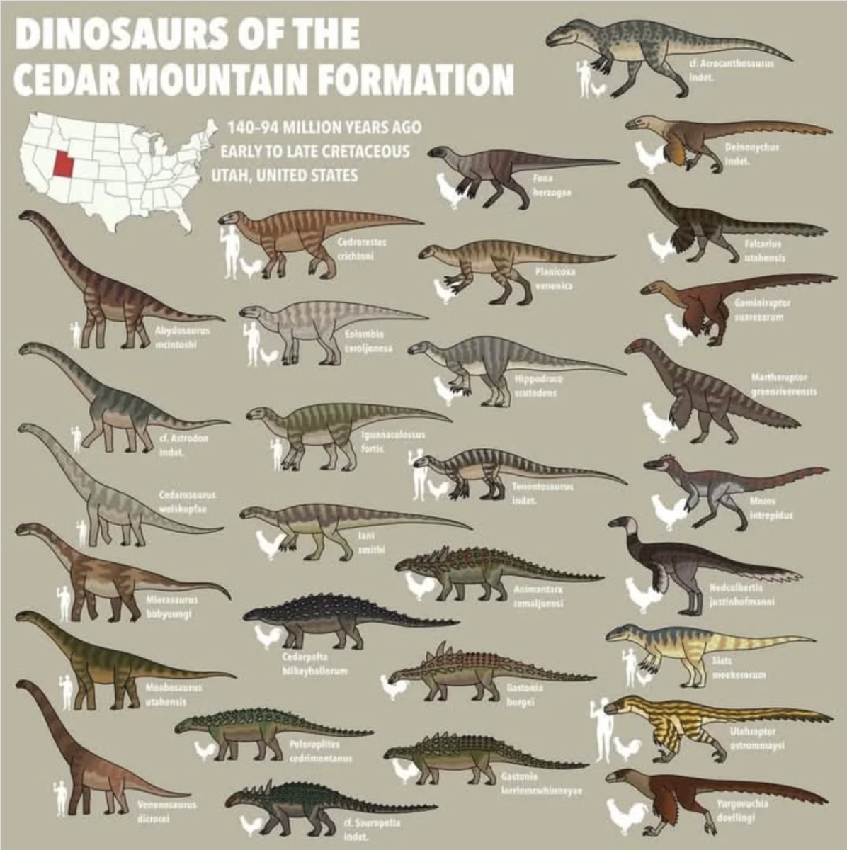

Slide 17
